Slide 1
Multiple Linear Regression and the General Linear Model
With Thanks to My Students in
AMS 572: Data Analysis

Slide 2
Outline
1. Introduction to Multiple Linear Regression
2. Statistical Inference
3. Topics in Regression Modeling
4. Example
5. Variable Selection Methods
6. Regression Diagnostic and Strategy for Building a Model

Slide 3
1.
Introduction to Multiple Linear Regression

Slide 4
Multiple Linear Regression
Regression analysis is a statistical methodology to estimate the relationship of a response variable to a set of predictor variables
Multiple linear regression extends simple linear regression model to the case of two or more predictor variable
Example:
A multiple regression analysis might show us that the demand of a product varies directly with the change in demographic characteristics (age, income) of a market area.
Historical Background
Francis Galton started using the term regression in his biology research
Karl Pearson and Udny Yule extended Galton’s work to the statistical context
Legendre and Gauss developed the method of least squares used in regression analysis
Ronald Fisher developed the maximum likelihood method used in the related statistical inference (test of the significance of regression etc.).
Notes:
Galton – example of his work: height of sons of 71” fathers is 67”, height of sons of 64” fathers is 67”

Slide 5
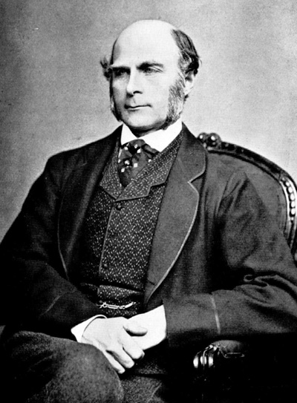

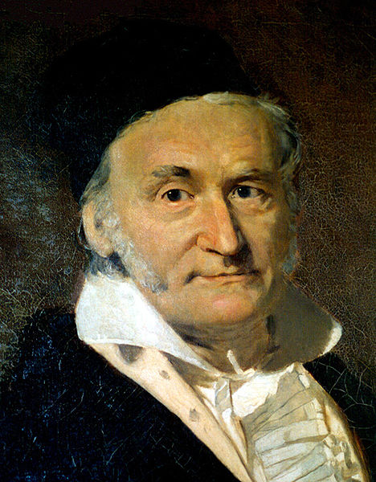
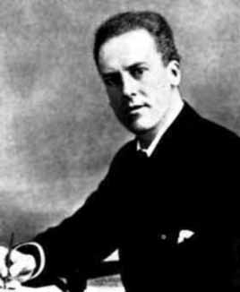

History
Karl Pearson.
Ronald Aylmer Fisher.
Francis Galton (1822/2/16 –1911/1/17).
He is regard by some as the founder of Biostatistics.
In his research he found that tall parents tend to have shorter children; and vice versa. So, the height of human being has the tendency to regress to its mean.
He coined the word “regression” for such phenomenon and problems.
Adrien-Marie Legendre (1752/9/18 -1833/1/10).
In 1805, he published an article named Nouvelles méthodes pour la détermination des orbites des comètes.
In this article, he introduced the Method of Least Squares to the world. He is the first person who published article on the method of least squares, which is the earliest form of regression.
Carl Friedrich Gauss (1777/4/30 – 1855/4/23).
He developed the fundamentals of the basis for least-squares analysis in 1795 at the age of eighteen.
He published an article entitled Theoria Motus Corporum Coelestium in Sectionibus Conicis Solem Ambientum in 1809.
In 1821, he published another article about least square analysis with further development, called Theoria combinationis observationum erroribus minimis obnoxiae. This article includes the Gauss–Markov theorem.
They both developed regression theory after Galton.
Most content in this page comes from Wikipedia
Notes:
Galton: Anyone who do not know me must know my cousin, Charles Darwin, who developed Evolutionary Theory.
http://forvo.com/word/adrien_marie_legendre/

Slide 6








Probabilistic Model
is the observed value of the random variable (r.v.)
which depends on
fixed predictor values
according to the following model:
Here
are unknown model parameters, and n is the number of observations.
The random error, , are assumed to be independent r.v.’s with mean 0 and variance
Thus are independent r.v.’s with mean and variance , where

Slide 7

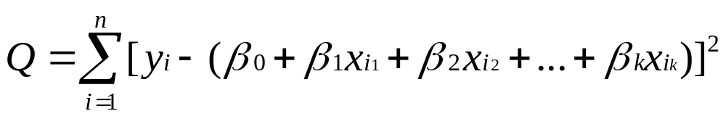

Fitting the model
The least squares (LS) method is used to find a line that fits the equation
Specifically, LS provides estimates of the unknown model parameters,
which minimizes, , the sum of squared difference of the
observed values, , and the corresponding points on the line with the same x’s
The LS can be found by taking partial derivatives of Q with respect to the unknown variables and setting them equal to 0. The result is a set of simultaneous linear equations.
The resulting solutions, are the least squares (LS) estimators of , respectively.
Please note the LS method is non-parametric. That is, no probability distribution assumptions on Y or ε are needed.

Slide 8



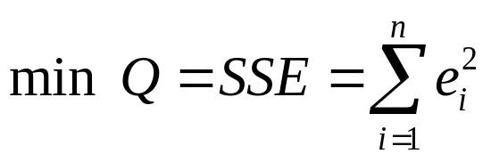
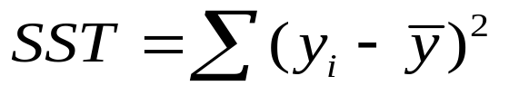

Goodness of Fit of the Model
To evaluate the goodness of fit of the LS model, we use the residuals
defined by
are the fitted values:
An overall measure of the goodness of fit is the error sum of squares (SSE)
A few other definition similar to those in simple linear regression:
  total sum of squares (SST):
regression sum of squares (SSR):
Notes:
SST is the SSE obtained when fitting the model Yi = B0 + ei, which ignores all the x’s
R^2 = 0.5 means 50% of the variation in y is accounted for by x, in this case, all x’s

Slide 9

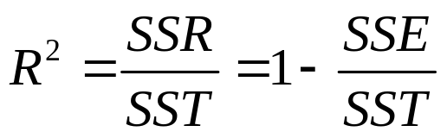

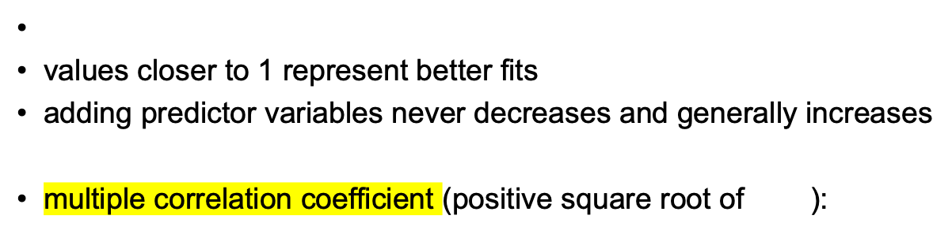

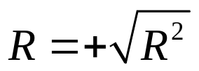
only positive square root is used
R is a measure of the strength of the association between the predictors (x’s) and the one response variable Y

Slide 10
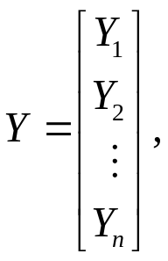
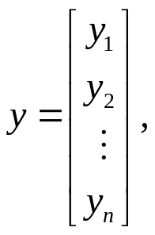
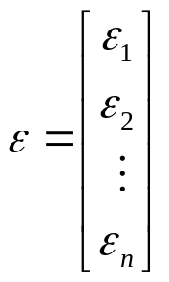



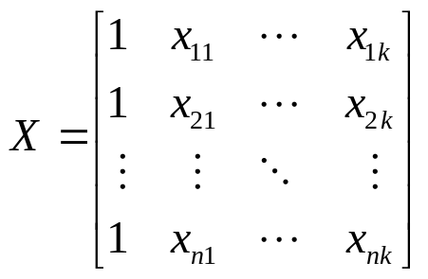

Multiple Regression Model in Matrix Notation
The multiple regression model can be represented in a compact form using matrix notation
Let:
be the n x 1 vectors of the r.v.’s , their observed values , and random errors , respectively for all n observations
Let:
be the n x (k + 1) matrix of the values of the predictor variables for all n observations
(the first column corresponds to the constant term )

Slide 11
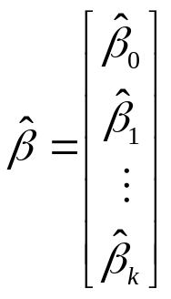
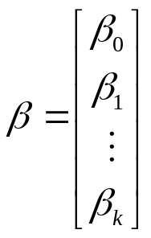




Let:
and
be the (k + 1) x 1 vectors of unknown model parameters and their LS estimates, respectively
The model can be rewritten as:
The simultaneous linear equations whose solutions yields the LS estimates:
If the inverse of the matrix exists, then the solution is given by:

Slide 12
2.
Statistical Inference

Slide 13
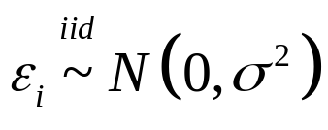









Determining the statistical significance of the predictor variables:
For statistical inferences, we need the assumption that
*i.i.d. means independent & identically distributed
We test the hypotheses:
vs.
If we can’t reject
, then the corresponding variable
is not a significant predictor of y.
It is easily shown that each
is normal with mean
and variance
, where
is the jth diagonal entry of the
matrix

Slide 14
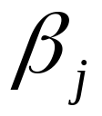


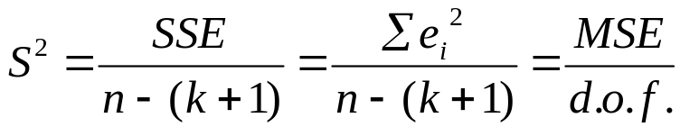
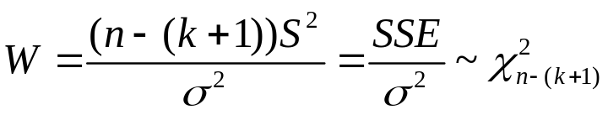


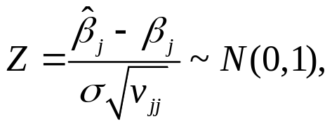

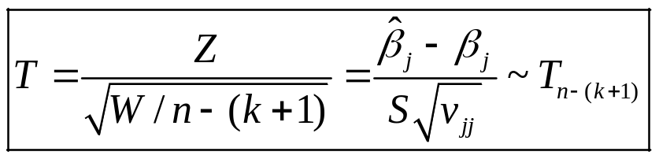
Deriving a pivotal quantity for the inference on
Recall
The unbiased estimator of the unknown error variance
is given by
We also know that
, and that
and
are statistically independent.
With
and by the definition of the t-distribution,
we obtain the pivotal quantity for the inference on

Slide 15
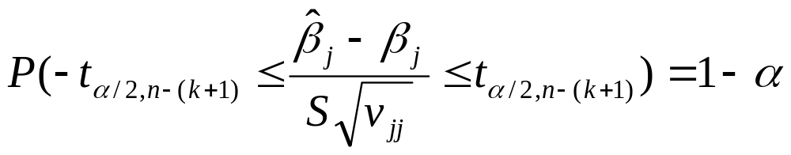

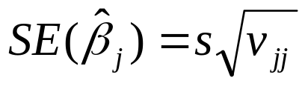
Derivation of the Confidence Interval for
Thus the 100(1-α)% confidence interval for is:
where

Slide 16
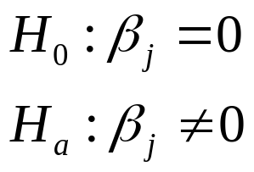
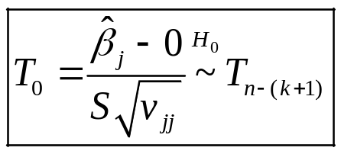
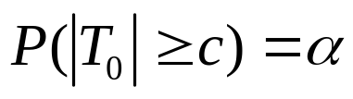
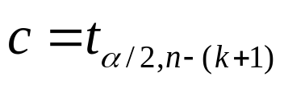
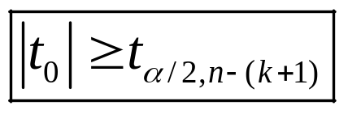


Derivation of the Hypothesis Test for at the significance level α
Hypotheses:
The test statistic is:
The decision rule of the test is derived based on the Type I error rate α. That is
P (Reject H₀ | H₀ is true) =
⇨
Therefore, we reject H₀ at the significance level α if and only
if , where is the observed value of

Slide 17




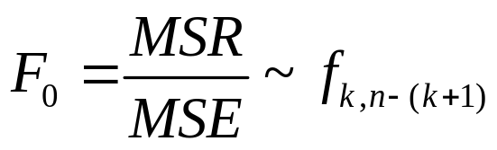

Another Hypothesis Test
for all
Now consider:
for at least one
When H₀ is true, the test statistics
An alternative and equivalent way to make a decision for a statistical
test is through the p-value, defined as:
p = P(observe a test statistic value at least as extreme as the one observed
At the significance level α, we reject H₀ if and only if p < α

Slide 18


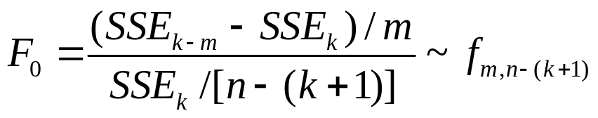
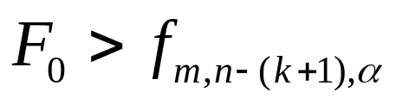
The General Hypothesis Test
Consider the full model:
(i=1,2,…n)
Now consider a partial model:
(i=1,2,…n)
Hypotheses:
vs.
for at least one
Test statistic:
Reject H₀ when

Slide 19


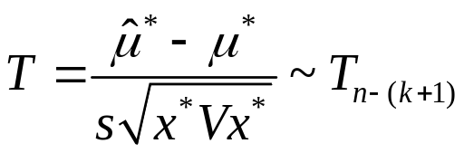


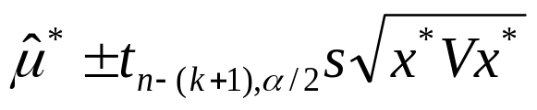
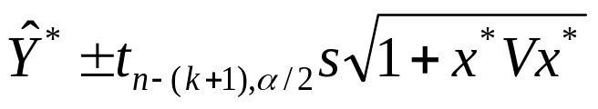
Estimating and Predicting Future Observations
Let
and let
The pivotal quantity for is
Using this pivotal quantity, we can derive a CI for the estimated mean :
Additionally, we can derive a prediction interval (PI) to predict Y*:

Slide 20
3.
Topics in Regression Modeling

Slide 21
3.1 Multicollinearity
Definition. The predictor variables are linearly dependent.
This can cause serious numerical and statistical difficulties in fitting the regression model unless “extra” predictor variables are deleted.

Slide 22
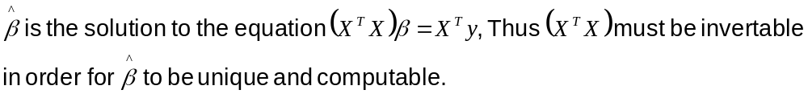



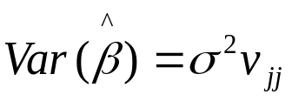

How does the multicollinearity cause difficulties?
If the approximate multicollinearity happens:
is nearly singular, which makes numerically unstable. This reflected in large changes in their magnitudes with small changes in data.
The matrix has very large elements. Therefore, are large, which makes statistically nonsignificant.

Slide 23


Measures of Multicollinearity
The correlation matrix R.
Easy but can’t reflect linear relationships between more than two variables.
Determinant of R can be used as measurement of singularity of .
Variance Inflation Factors (VIF): the diagonal elements of . VIF>10 is regarded as unacceptable.

Slide 24
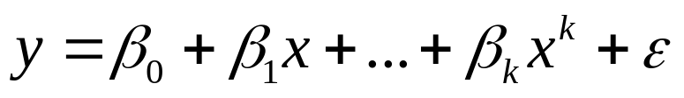
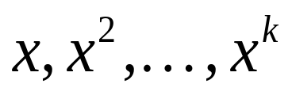
3.2 Polynomial Regression
A special case of a linear model:
Problems:
The powers of x, i.e., tend to be highly correlated.
If k is large, the magnitudes of these powers tend to vary over a rather wide range.
So, set k<=3 is a good idea, and almost never use k>5.

Slide 25
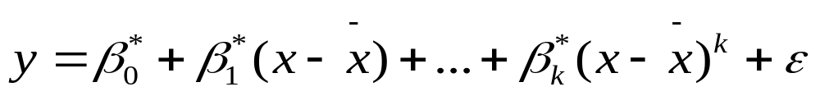

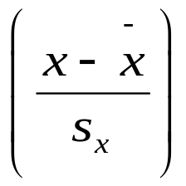
Solutions
Centering the x-variable:
Effect: removing the non-essential multicollinearity in the data.
Furthermore, we can standardize the data by dividing the standard deviation of x:
Effect: helping to alleviate the second problem.
Using the first few principal components of the original variables instead of the original variables.

Slide 26
3.3 Dummy Predictor Variables & The General Linear Model
How to handle the categorical predictor variables?
If we have categories of an ordinal variable, such as the prognosis of a patient (poor, average, good), one can assign numerical scores to the categories. (poor=1, average=2, good=3)

Slide 27
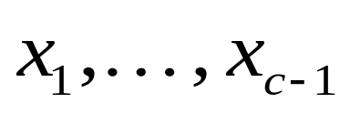
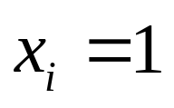

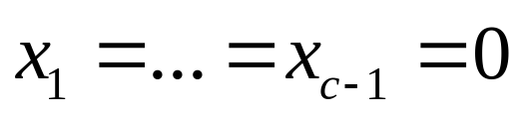
For a categorial predictor with c>=2 categories, we can use c-1 indicator variables, , called Dummy Variables, to code this categorical variable.
for the i^{th} category,
for the c^{th} category – which is treated as the baseline.

Slide 28
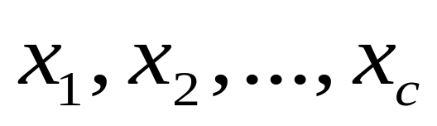
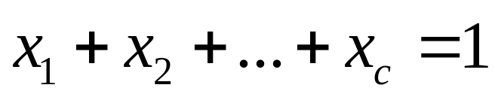
Why don’t we just use c indicator variables:
?
If we do that, there will be a linear dependency among these c variables:
This will cause multicollinearity.

Slide 29
Example of the dummy variables
For instance, if we have four years of quarterly sale data of a certain brand of soda. How can we model the time trend by fitting a multiple regression equation?
Solution: We use quarter as a predictor variable x1. To model the seasonal trend, we use indicator variables x2, x3, x4, for Winter, Spring and Summer, respectively. For Fall, all three equal zero. That means: Winter-(1,0,0), Spring-(0,1,0), Summer-(0,0,1), Fall-(0,0,0).
Then we have the model:

Slide 30
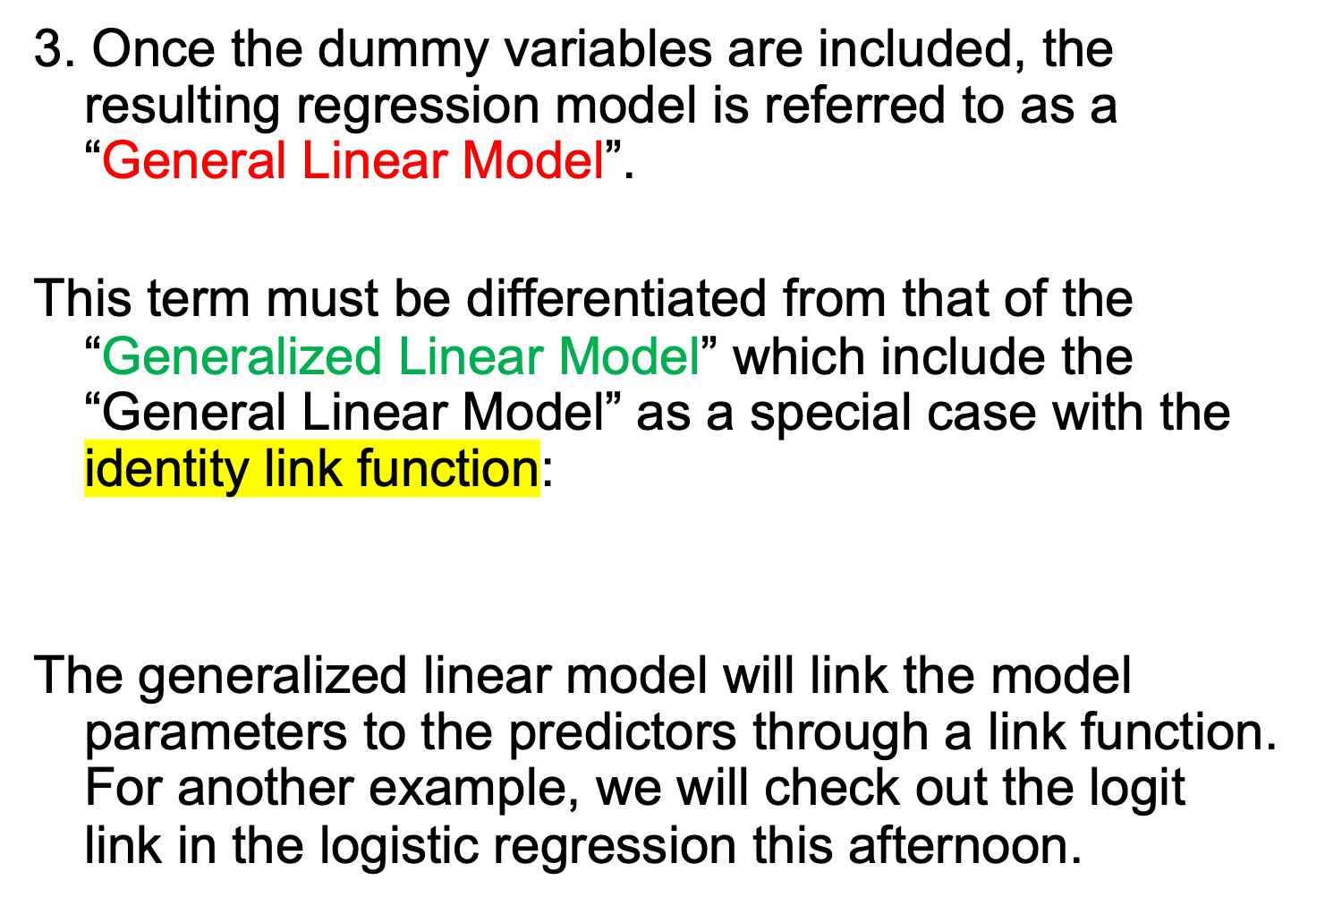

Slide 31
4. Example
Here we revisit the classic regression towards Mediocrity in Hereditary Stature by Francis Galton
He performed a simple regression to predict offspring height based on the average parent height
Slope of regression line was less than 1 showing that extremely tall parents had less extremely tall children
At the time, Galton did not have multiple regression as a tool so he had to use other methods to account for the difference between male and female heights
We can now perform multiple regression on parent-offspring height and use multiple variables as predictors

Slide 32

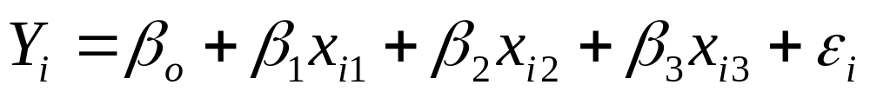
Example
Y = height of child
x₁ = height of father
x₂ = height of mother
x₃ = gender of child

Slide 33
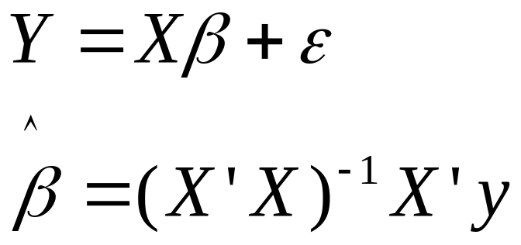
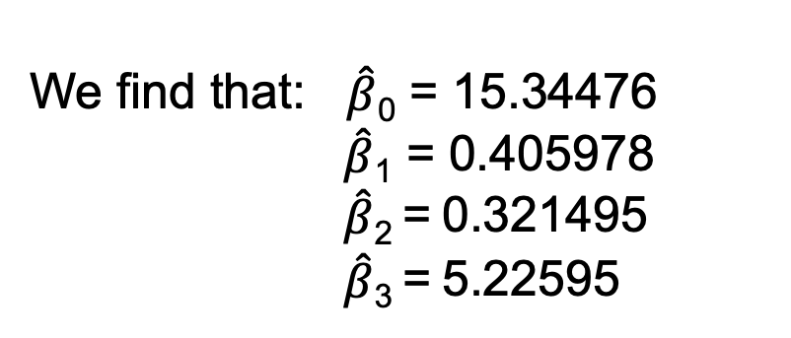
Example
In matrix notation:

Slide 34
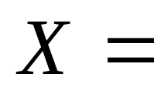
Example
 | Father | Mother | Gender | Child
1 | 78.5 | 67 | 1 | 73.2
1 | 78.5 | 67 | 1 | 69.2
1 | 78.5 | 67 | 0 | 69
1 | 78.5 | 67 | 0 | 69
1 | 75.5 | 66.5 | 1 | 73.5
1 | 75.5 | 66.5 | 1 | 72.5
1 | 75.5 | 66.5 | 0 | 65.5
1 | 75.5 | 66.5 | 0 | 65.5
1 | 75 | 64 | 1 | 71
1 | 75 | 64 | 0 | 68
… | … | … | … | …

Slide 35


Example
Important calculations
Is the predicted height of each child given a set of predictor variables

Slide 36

Example
Are these values significantly different than zero?
H_{o}: β_{j} = 0
H_{a}: β_{j} ≠ 0
Reject H_{0j} if

Slide 37
Example
 | β-estimate | SE | t
Intercept | 15.3 | 2.75 | 5.59*
Father Height | 0.406 | 0.0292 | 13.9*
Mother Height | 0.321 | 0.0313 | 10.3*
Gender | 5.23 | 0.144 | 36.3*
* p<0.05. We conclude that all β are significantly different than zero.

Slide 38


Testing the model as a whole:
H_{o}: β₀ = β₁ = β₂ = β₃ = 0
H_{a}: The above is not true.
Reject H₀ if
Since F = 529.032 >2.615, we reject H_{o} and conclude that our model predicts height better than by chance.

Slide 39



Making Predictions
Let’s say George Clooney (71 inches) and Madonna (64 inches) have a baby boy.
95% Prediction interval:
69.97 ± 4.84 = (65.13, 74.81)

Slide 40
SAS code
ods graphics on
data revise;
set mylib.galton;
if sex = 'M' then gender = 1.0;
else gender = 0.0;
run;
proc reg data=revise;
title "Dependence of Child Heights on Parental Heights";
model height = father mother gender / vif;
run;
quit;
Alternatively, one can use proc GLM procedure that can incorporate the categorical variable (sex) directly via the class statement.

Slide 41
Dependence of Child Heights on Parental Heights 2
The REG Procedure
Model: MODEL1
Dependent Variable: height height
Number of Observations Read 898
Number of Observations Used 898
Analysis of Variance
Sum of Mean
Source DF Squares Square F Value Pr > F
Model 3 7365.90034 2455.30011 529.03 <.0001
Error 894 4149.16204 4.64112
Corrected Total 897 11515
Root MSE 2.15433 R-Square 0.6397
Dependent Mean 66.76069 Adj R-Sq 0.6385
Coeff Var 3.22694
Parameter Estimates
Parameter Standard
Variable Label DF Estimate Error t Value Pr > |t|
Intercept Intercept 1 15.34476 2.74696 5.59 <.0001
father father 1 0.40598 0.02921 13.90 <.0001
mother mother 1 0.32150 0.03128 10.28 <.0001
gender 1 5.22595 0.14401 36.29 <.0001
Parameter Estimates
Variance
Variable Label DF Inflation
Intercept Intercept 1 0
father father 1 1.00607
mother mother 1 1.00660
gender 1 1.00188

Slide 42


Slide 43

By
Gary Bedford &
Christine Vendikos

Slide 44
5. Variables Selection Method
A. Stepwise Regression

Slide 45
Variables selection method
(1) Why do we need to select the variables?
(2) How do we select variables?
* stepwise regression
* best subset regression

Slide 46

Stepwise Regression
(p-1)-variable model:
P-variable model

Slide 47



Slide 48

Partial correlation coefficients

Slide 49
5. Variables selection method
Stepwise Regression:
SAS Example

Slide 50
Example 11.5 (T&D pg. 416), 11.9 (T&D pg. 431)
The following table shows data on the heat evolved in calories during the hardening of cement on a per gram basis (y) along with the percentages of four ingredients: tricalcium aluminate (x1), tricalcium silicate (x2), tetracalcium alumino ferrite (x3), and dicalcium silicate (x4).
No. | X1 | X2 | X3 | X4 | Y
1 | 7 | 26 | 6 | 60 | 78.5
2 | 1 | 29 | 15 | 52 | 74.3
3 | 11 | 56 | 8 | 20 | 104.3
4 | 11 | 31 | 8 | 47 | 87.6
5 | 7 | 52 | 6 | 33 | 95.9
6 | 11 | 55 | 9 | 22 | 109.2
7 | 3 | 71 | 17 | 6 | 102.7
8 | 1 | 31 | 22 | 44 | 72.5
9 | 2 | 54 | 18 | 22 | 93.1
10 | 21 | 47 | 4 | 26 | 1159
11 | 1 | 40 | 23 | 34 | 83.8
12 | 11 | 66 | 9 | 12 | 113.3
13 | 10 | 68 | 8 | 12 | 109.4

Slide 51
SAS Program (stepwise variable selection is used)
data example115;
input x1 x2 x3 x4 y;
datalines;
7 26 6 60 78.5
1 29 15 52 74.3
11 56 8 20 104.3
11 31 8 47 87.6
7 52 6 33 95.9
11 55 9 22 109.2
3 71 17 6 102.7
1 31 22 44 72.5
2 54 18 22 93.1
21 47 4 26 115.9
1 40 23 34 83.8
11 66 9 12 113.3
10 68 8 12 109.4
;
run;
proc reg data=example115;
model y = x1 x2 x3 x4 /selection=stepwise;
run;

Slide 52
Selected SAS output
The SAS System 22:10 Monday, November 26, 2006 3
The REG Procedure
Model: MODEL1
Dependent Variable: y
Stepwise Selection: Step 4
Parameter Standard
Variable Estimate Error Type II SS F Value Pr > F
Intercept 52.57735 2.28617 3062.60416 528.91 <.0001
x1 1.46831 0.12130 848.43186 146.52 <.0001
x2 0.66225 0.04585 1207.78227 208.58 <.0001
Bounds on condition number: 1.0551, 4.2205
----------------------------------------------------------------------------------------------------

Slide 53
SAS Output (cont)
All variables left in the model are significant at the 0.1500 level.
No other variable met the 0.1500 significance level for entry into the model.
Summary of Stepwise Selection
Variable Variable Number Partial Model
Step Entered Removed Vars In R-Square R-Square C(p) F Value Pr > F
1 x4 1 0.6745 0.6745 138.731 22.80 0.0006
2 x1 2 0.2979 0.9725 5.4959 108.22 <.0001
3 x2 3 0.0099 0.9823 3.0182 5.03 0.0517
4 x4 2 0.0037 0.9787 2.6782 1.86 0.2054

Slide 54
5. Variables selection method
B. Best Subset Regression

Slide 55
Best Subset Regression
For the stepwise regression algorithm
The final model is not guaranteed to be optimal in any specified sense.
In the best subset regression,
subset of variables is chosen from the collection of all subsets of k predictor variables) that optimizes a well-defined objective criterion

Slide 56
Best Subset Regression
In the stepwise regression,
We get only one single final models.
In the best subset regression,
The investor could specify a size for the predictors for the model.

Slide 57




Best Subset Regression
Optimality Criteria
r_{p}²-Criterion:
Adjusted r_{p}²-Criterion:
C_{p}-Criterion (recommended for its ease of computation and its ability to judge the predictive power of a model)
The sample estimator, Mallows’ C_{p}-statistic, is given by

Slide 58
Best Subset Regression
Algorithm
Note that our problem is to find the minimum of a given function.
Use the best subset regression algorithm and replace the partial F criterion with other criterion such as C_{p}.
Enumerate all possible cases and find the minimum of the criterion functions.
Other possibility?

Slide 59
Best Subset Regression & SAS
proc reg data=example115;
model y = x1 x2 x3 x4 /selection=ADJRSQ;
run;
For the selection option, SAS has implemented 9 methods in total. For best subset method, we have the following options:
Maximum R² Improvement (MAXR)
Minimum R² (MINR) Improvement
R² Selection (RSQUARE)
Adjusted R² Selection (ADJRSQ)
Mallows' C_{p} Selection (CP)

Slide 60
6. Building A Multiple Regression Model
Steps and Strategy

Slide 61
Modeling is an iterative process. Several cycles of the steps maybe needed before arriving at the final model.
The basic process consists of seven steps

Slide 62
Get started and Follow the Steps
Categorization by Usage Collect the Data
Divide the Data Explore the Data
Fit Candidate Models
Select and Evaluate
Select the Final Model

Slide 63

Step I
Decide the type of model needed, according to different usage.
Main categories include:
Predictive
Theoretical
Control
Inferential
Data Summary
Sometimes, models are involved in multiple purposes.

Slide 64
Step II
Collect the Data
Predictor (X)
Response (Y)
Data should be relevant and bias-free

Slide 65
Step III
Explore the Data
Linear Regression Model is sensitive to the noise. Thus, we should treat outliers and influential observations cautiously.

Slide 66
Step IV
Divide the Data
Training Sets: building
Test Sets: checking
How to divide?
Large sample Half-Half
Small sample size of training set >16

Slide 67
Step V
Fit several Candidate Models
Using Training Set.

Slide 68
Step VI
Select and Evaluate a Good Model
To improve the violations of model assumptions.

Slide 69
Step VII
Select the Final Model
Use test set to compare competing models by cross-validating them.

Slide 70
Regression Diagnostics (Step VI)
Graphical Analysis of Residuals
  Plot Estimated Errors vs. X_{i} Values
    Difference Between Actual Y_{i} & Predicted Y_{i}
    Estimated Errors Are Called Residuals
  Plot Histogram or Stem-&-Leaf of Residuals
Purposes
  Examine Functional Form (Linearity )
  Evaluate Violations of Assumptions

Slide 71
Linear Regression Assumptions
Mean of Probability Distribution of Error Is 0
Probability Distribution of Error Has Constant Variance
Probability Distribution of Error is Normal
Errors Are Independent

Slide 72



Residual Plot for Functional Form (Linearity)
Add X^2 Term
Correct Specification

Slide 73


Residual Plot for Equal Variance
Unequal Variance
Correct Specification
Fan-shaped.
Standardized residuals used typically (residual
divided by standard error of prediction)

Slide 74

Residual Plot for Independence
Not Independent
Correct Specification

Slide 75
That is all.
Any questions?

